Slide 1
Managing and Navigating WinRMS
Session 2: Salary Management
Jamece Petteway, Supervisory Budget Analyst – Durham
Kari Points, Director Research Operations Iowa City
Antonio Laracuente, Director Field Operations - ORD
June 16, 2021

Slide 2
Objectives
4 Sessions
  TDAs – Allocations and Distributions including Prior Year – June 15
  Salary Management - June 16
  How to Manage the Noise in WinRMS – June 22
  Setting up Accounts, Expense Transfers and Split Account Transactions – June 23

Slide 3
Presenters
Antonio Laracuente – Director Field Operations, ORD
Kari Points – Director Research Operations – Iowa City
Tabitha Randall – Supervisory Budget Analyst – Salt Lake City
Jamece Petteway – Supervisory Budget Analyst – Durham
Travis Peake – Supervisory Budget Analyst – Portland
Erin Olson – Supervisory Budget Analyst – St. Louis

Slide 4
Disclaimers and Thoughts
These are ideas that we are presenting to make WinRMS useful. If you have better ideas or ways to manage, please send those to any of us.
There are many ways to attack WinRMS however the presentations are based on the long term experiences of the users
Do not hesitate to contact any of us to help out
If you do not have WinRMS and would like it, please contact Kashif Iqbal or myself
It takes a few months to get WinRMS going at a station
The larger the station the more effective WinRMS is since it manages many accounts and control points
It takes daily management to make this work
You need to utilize other tools such as VSSC and IFCAP (VISTA) to reconcile and manage

Slide 5
Rules of Engagement
Salary comes directly from the PAID system through VISTA download
Transactions occur at the Control point level. WinRMS does not split a transaction among several Control Points
  Salaries hit one control point in FMS – you have to let them hit one FCP in WinRMS then transfer the cost (ex. HSR and CSR splits)
Salaries can be downloaded but you must have access to the salary FCPs (preferably as an FCP approving official)
Always reconcile to what hits FMS because that is the actual cost
Salaries can be projected to the whole year or partial
Sometimes salaries hit PAID but do not download
Track Rejects

Slide 6
What is a Reject
A reject occurs when an employee is not coded to the correct control point and the salary defaults to Program 81
  Has to be a research CC
  Usually a FCP is not assigned by payroll
  The reject will show as a separate transaction in FMS a few days after payroll
To correct you must contact payroll to properly place the employee in the control point
You must enter the transaction separately into WinRMS as they more than likely did not download.

Slide 7
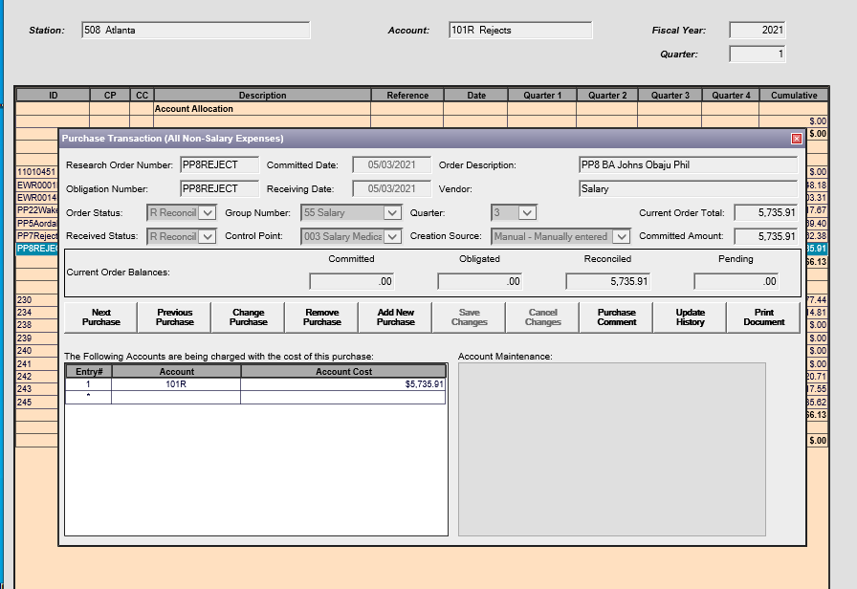
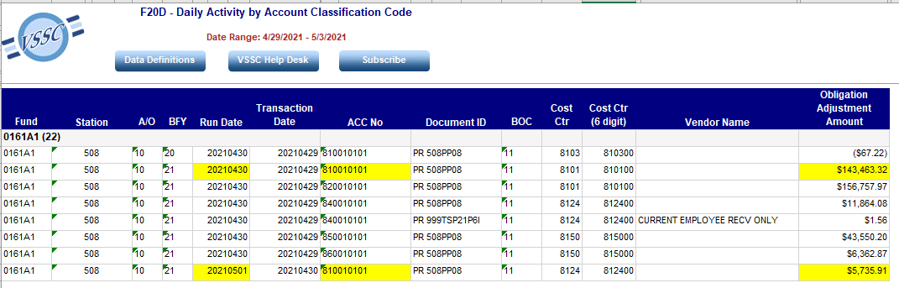
Example of Reject Transaction

Slide 8
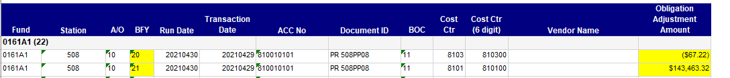
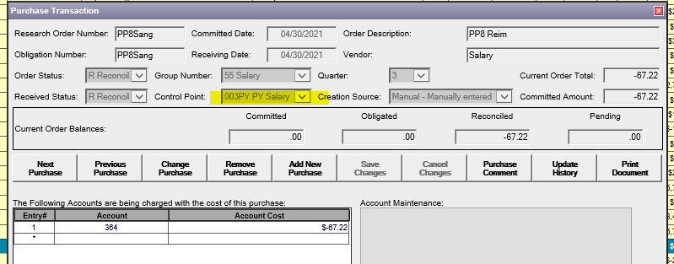
Employees who hit two fiscal years (Adj. CY Amount)
Employee is paying back money
Payroll transactions hit multiple fiscal years

Slide 9
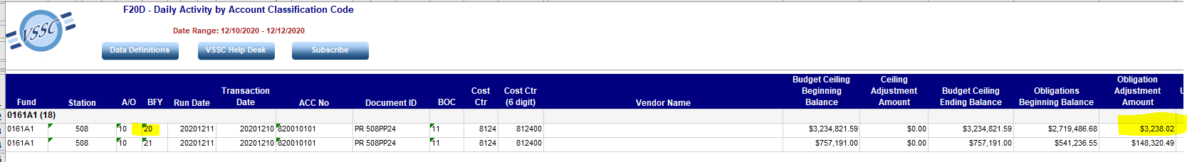
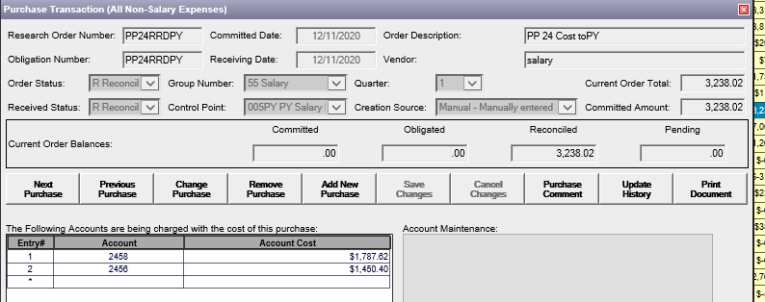
Employees who hit two fiscal years (Adj. CY Amount)
Employee was given retroactive pay

Slide 10
How to Download
Key points:
  You must have access (clerk or approving official) in VISTA to all salary and all other FCPs you wish to download
  You must have these brokers provided by the VISTA folks
    CWMail used to verify the Broker
    ARH WINRMS BROKER CONTEXT WinRMS RPC Broker Context
  You must have either RVI1 or RVI2 available – part of WinRMS. Based on Version of VISTA at your site
    RVI1 full salary download
    RVI2 only the FCPs you request
  Make sure you have the Salary FCPs setup in WinRMS

Slide 11
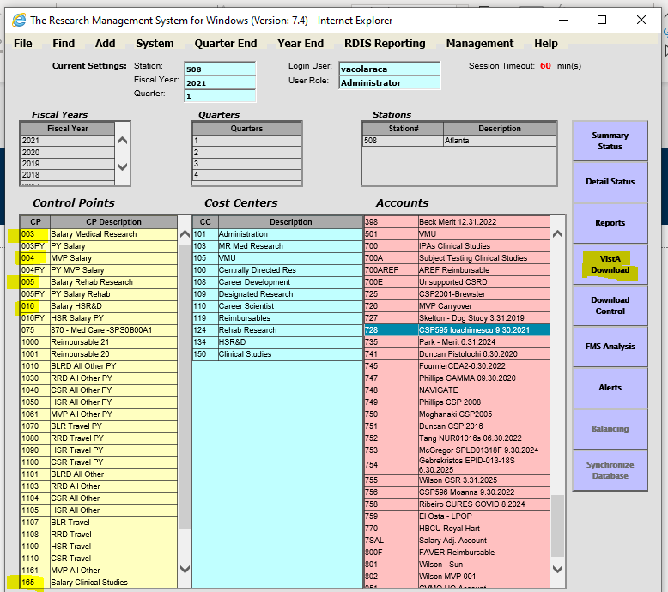
How to Download Cont.

Slide 12
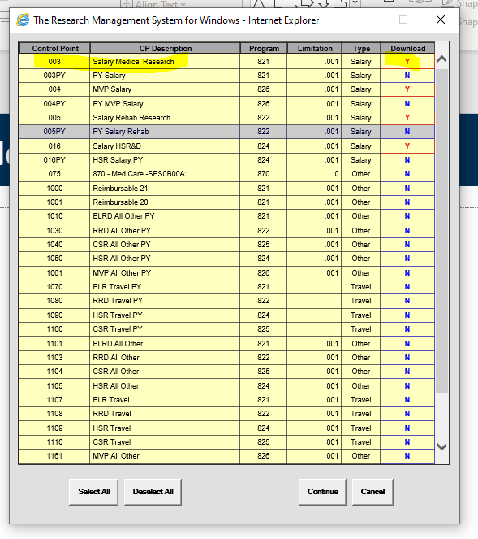
How to Download Cont.

Slide 13
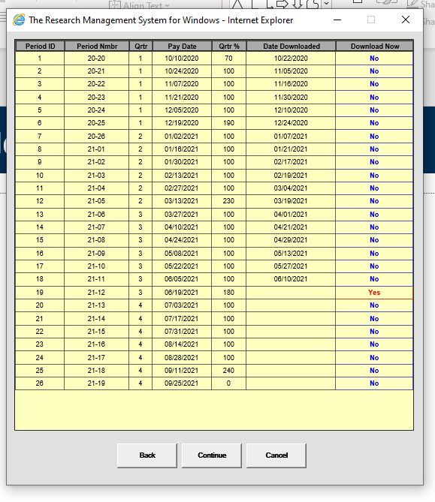
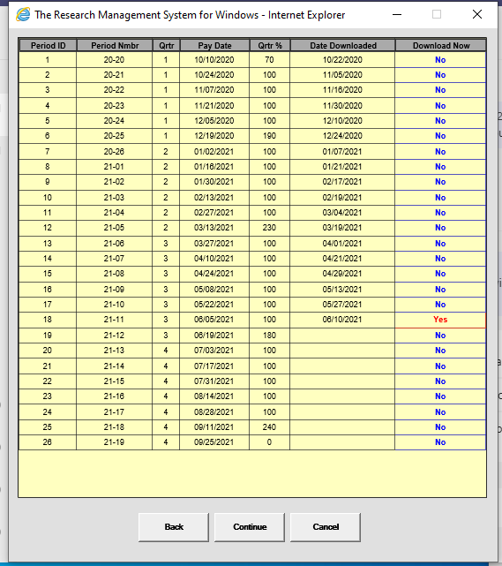
How to Download Cont.

Slide 14
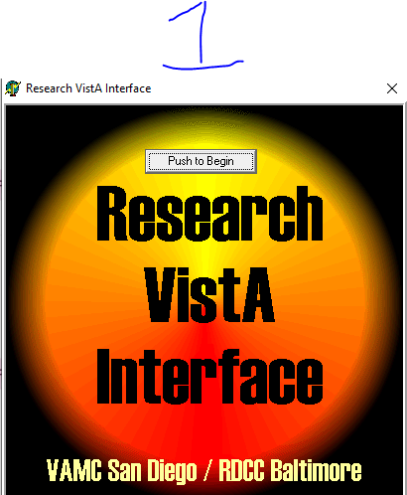
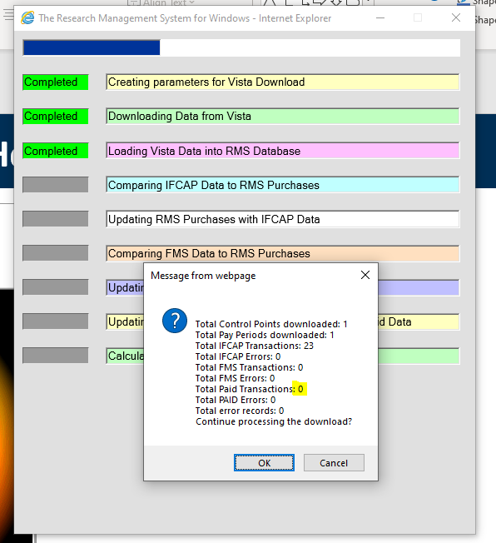
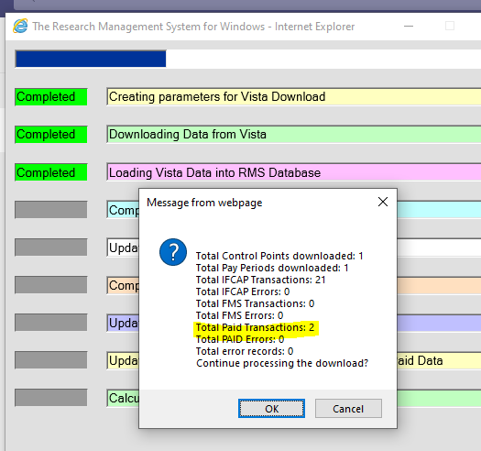
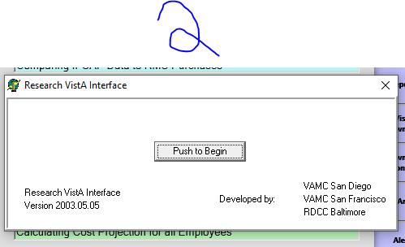
How to Download Cont.

Slide 15
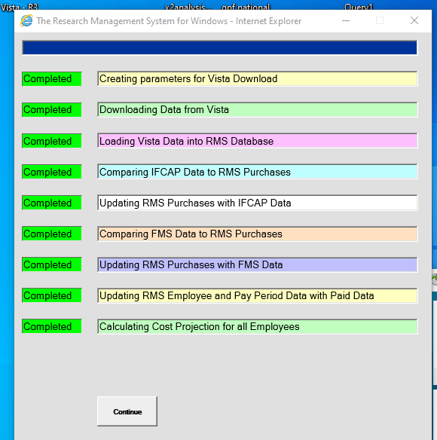
How to Download Cont.

Slide 16
After the Download
Key points
  Once you download you go to Alerts
    Sometimes you will download people from PAID that look like they are charged to your FCP but they are not.
    Primary reason is the CC (column BB) is a med care Cost Center so they reject to med care
    You can remove those transaction by going to Alerts
    You may also get additional adjustments from the download that are manual in IFCAP but do not impact FMS (delete those)
    New Employees will show in Alerts

Slide 17
What to do when someone does not show up
Each time a download occurs a file is created in c:\JRMS\data\output.parsed.paid
If you use RVI 1 (download script), you can see a listing of the people downloaded from PAID and you can then see what FCP they hit and what CC they are tied to.
It is critical that the FCP is accurate because that is what the download script uses to tie to WinRMS.
You can then identify the person and where they are hitting.
Primary cause is No or Wrong FCP

Slide 18
Recap Problems
Name |  | plan | GradeStep1 | GradeStep2 | CP | hours | TL | column AB | Column BB
 | GS/CA/SL/GW | GS/CA/SL/GW |  |  |  | 80 |  | 4485.05 | 8124 | 8124 | missing in download
 | GS/CA/SL/GW | GS/CA/SL/GW |  |  | 12 |  |  |  | 8101 | 8101 | Reject
 | GS/CA/SL/GW | GS/CA/SL/GW |  |  | 16 | 80 | 271 | 8613.21 | 8402 | 8402 | showed in download but not research

Slide 19
Correct Alerts
For those who are not in Research but downloaded - go to alerts and remove. Note: Use Delete Alerts Only when removing an employee that is not supposed to be there. Do not use for purchase transactions as it only deletes the alert and not the transaction in WinRMS. If the employee is not corrected by payroll, they will continue to download.

Slide 20
How to Setup New Employees
When there is a new employee to a Research FCP, it will automatically download the data and show-up in Alerts.
You will want to click on the Alert and Add New Employee Record.
All the Data will be there except for the Account Information.
You will want to change the employee to reflect the account(s) it should be charged to each quarter.
Note: You will need an entry for each quarter going back to the beginning of the fiscal year.

Slide 21
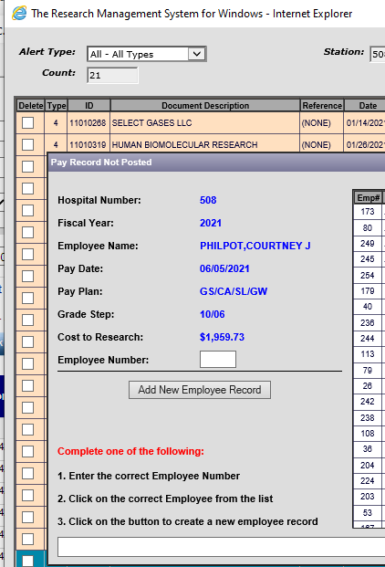
New Employee Screen

Slide 22
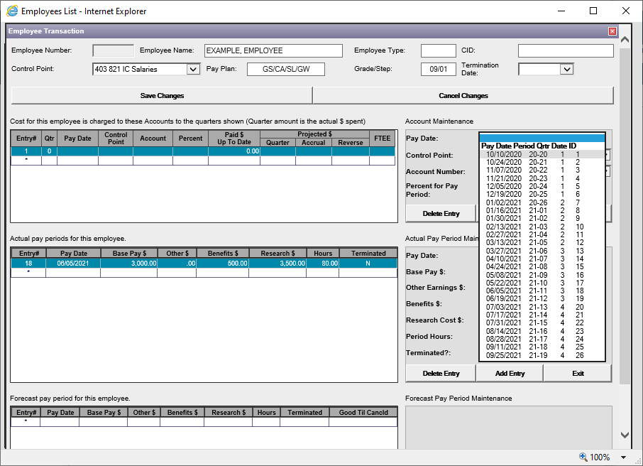
How to Setup New Employees
Select 1st PP in Qtr. 1
Click on Entry #1

Slide 23
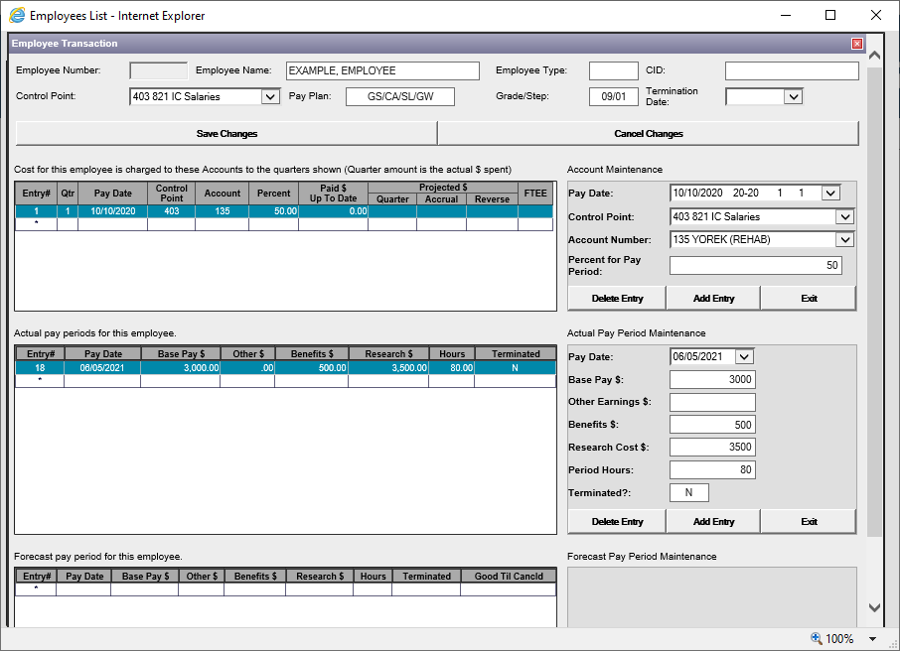
How to Setup New Employees
Select the FCP and Account Number
This is where you can split the employee amongst the Accounts. Enter the % of the employee salary that you want charged to this account.

Slide 24
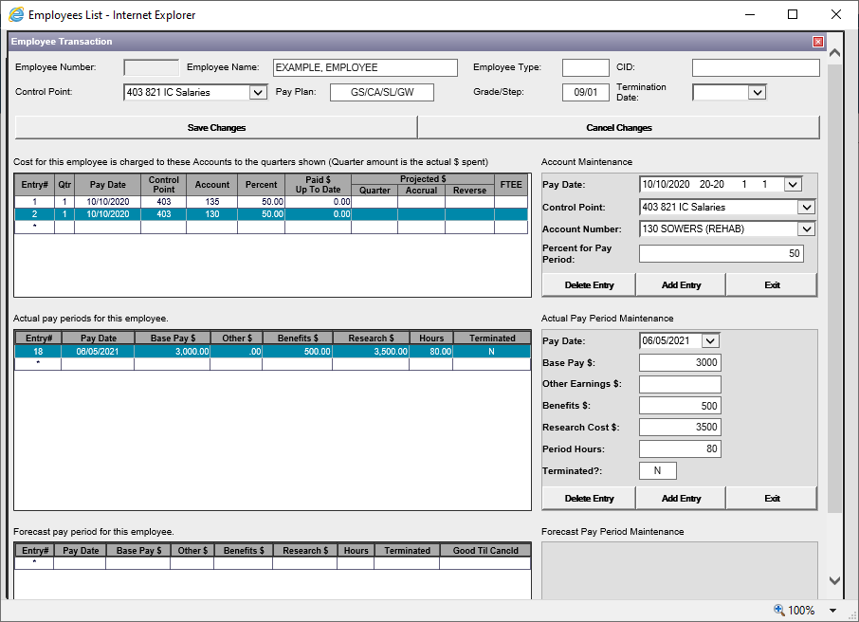
How to Setup New Employees
If you are splitting the employee costs amongst multiple accounts, you will need one entry per quarter for each account. The percent needs to total 100%

Slide 25
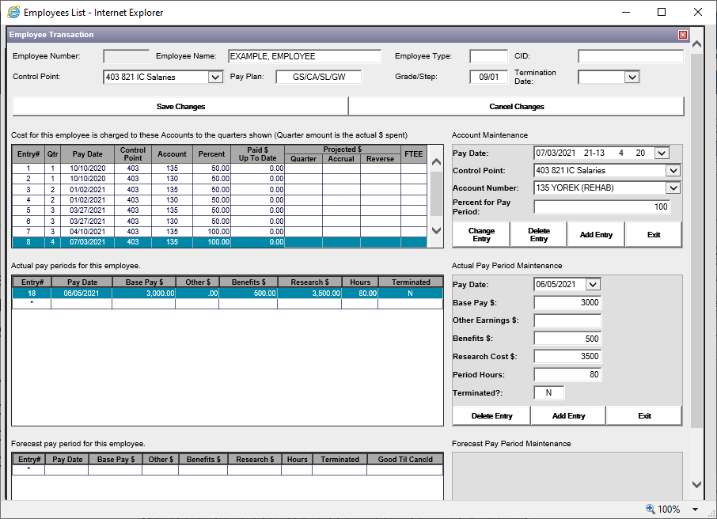
How to Set-up New Employees
You can also change the % split between accounts at any PP.

Slide 26
How to Manage Employees Who Have Left
For employees that have left, you will want to add a Termination Date so that the employee will no longer have a projection past their last pay period and WinRMS will not give you an error that an employee wasn’t paid.
Go to Find -> Find Employee -> And select the employee you want to Terminate.

Slide 27
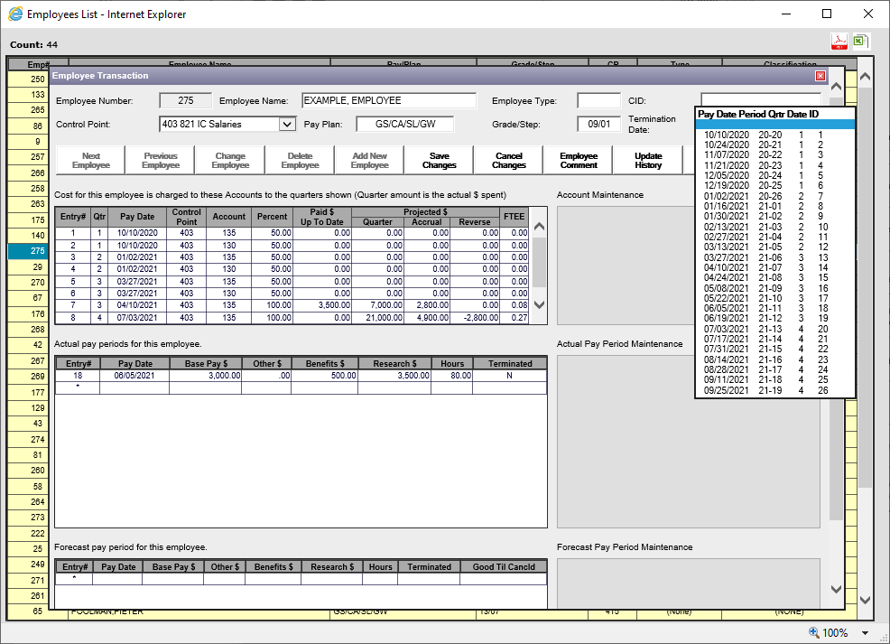
How to Manage Employees Who Have Left
And then select a Termination Date. Once done hit “Save Changes”
Click on Change Employee

Slide 28
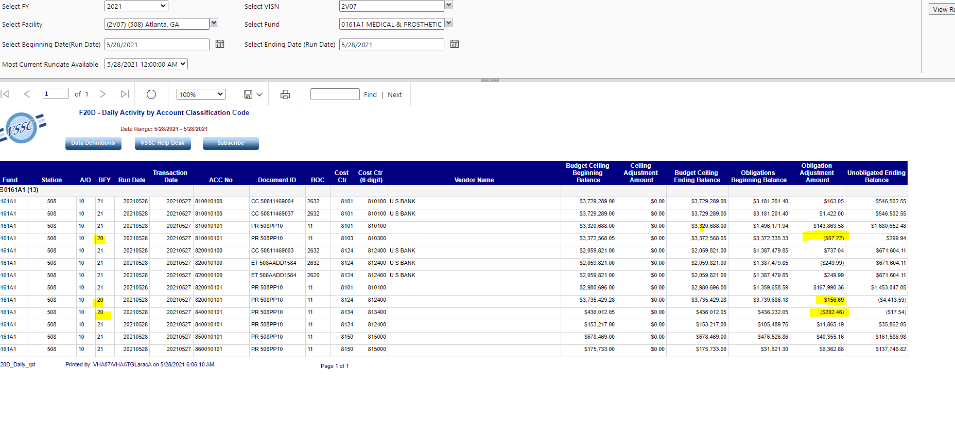
Reconciling Payroll
Open the Current Pay Period Report and match the cost to F20. Should match however if you may have employees who are paying back funds etc. and they hit prior year.
FMS differentiates the years while PAID does not. This means that you will have to look and see where the differences are so you can balance.

Slide 29
How to Enter Cost Transfers (EWs)
Cost Transfers (EWs) are typically done to close out Prior Year (PY) funds. They involve transferring costs from the current year (CY) FCPs to PY FCPs and are typically done with salaries.
Cost Transfers may also be used to transfer funds between the Medical Center and Research when expenses need to be reimbursed. For example, an individual’s time is split between MC and Research. They are paid from one appropriation and need to be reimbursed at a certain percent effort from another.
These transfers of costs need to be documented in WinRMS in order to balance.

Slide 30
How to Enter Cost Transfers (EWs)
In order to enter EWs in WinRMS, you will need to enter it as a purchase.
Go to Add –> Add Purchase and enter the EW information.
If EW is between Research FCPs, there will be two purchase transactions for each. One will be showing the costs being added to a PY FCP and one will be removing the costs from a CY FCP.
IF EW is between Research and Medical Center appropriation, you will be entering only one side of that transaction unless you are managing the MC FCP as well.

Slide 31
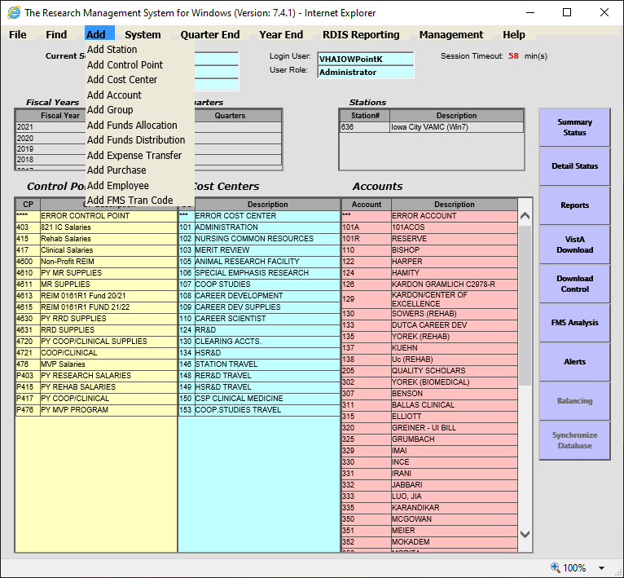
How to Enter Cost Transfers (EWs) cont.

Slide 32
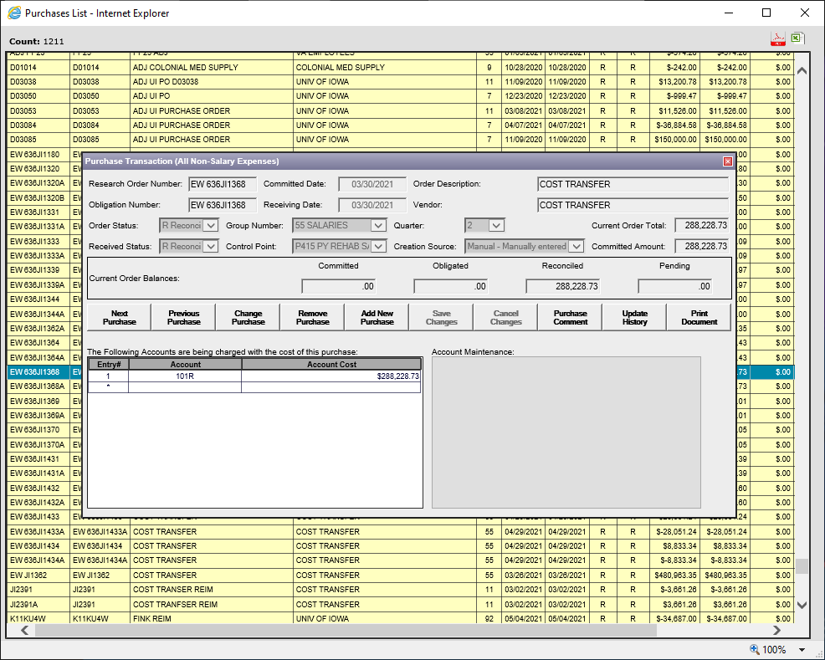
How to Enter Cost Transfers (EWs) cont.

Slide 33
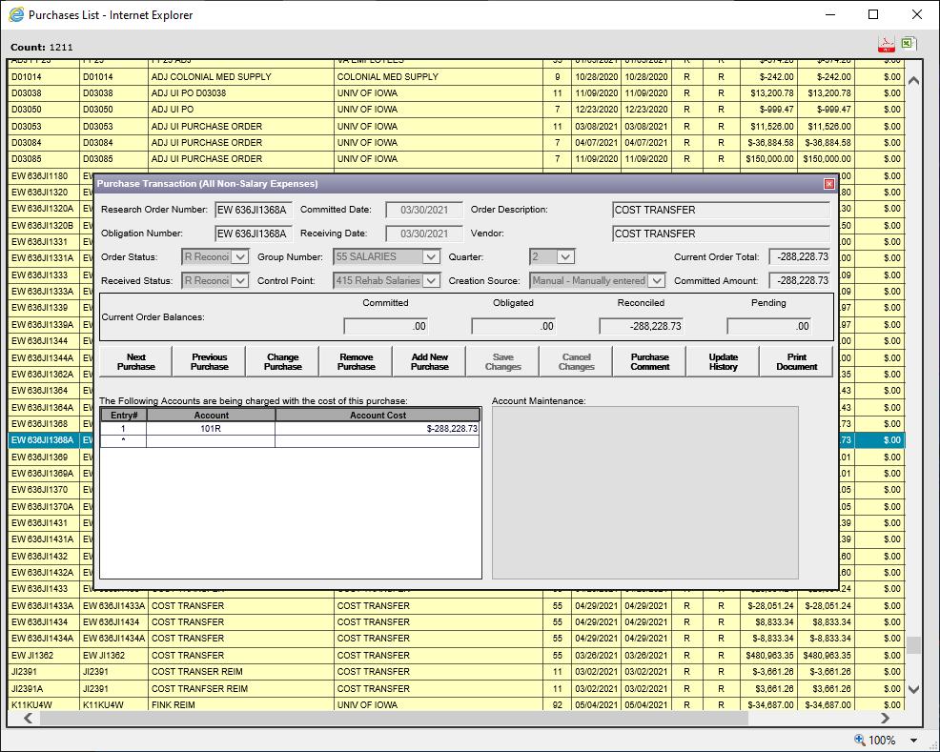
How to Enter Cost Transfers (EWs) cont.

Slide 34
FMS Balancing
It is extremely important to balance your WinRMS FCP balances to FMS!
The size and complexity of your program can determine how often you do this. Each time you do a download, you should balance the FCPs. For salaries, you should be doing this each pay period.
In order to balance, you will need the Status of Allowance (SOA). There are couple ways to get this:
  From your Fiscal Office (Budgeting)
  From the VSSC: VSSC - VHA Support Service Center (va.gov)

Slide 35
How to Balance Ceilings
You will want to ensure that the Account Ceilings report for each FCP matches the FMS Budget column on the SOA.
To find the Account Ceilings for each FCP in WinRMS, you can:
  Pull the Administrators Summary Report and look at the Account Ceilings report or
  On the home page, click on the FCP in yellow and select Summary Status or Detail Status in purple.
Let’s look at Iowa City’s FCP 403 for Salaries.

Slide 36
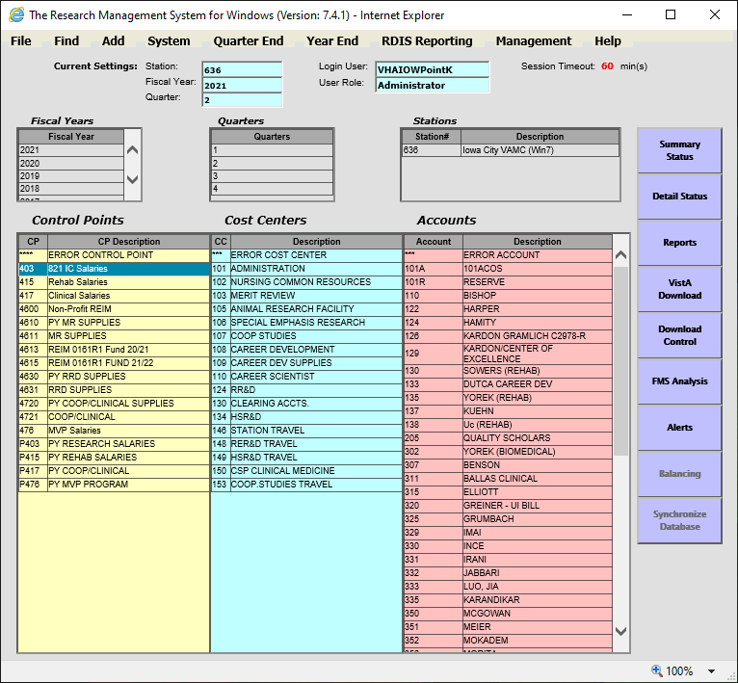
Administrators Summary Report

Slide 37
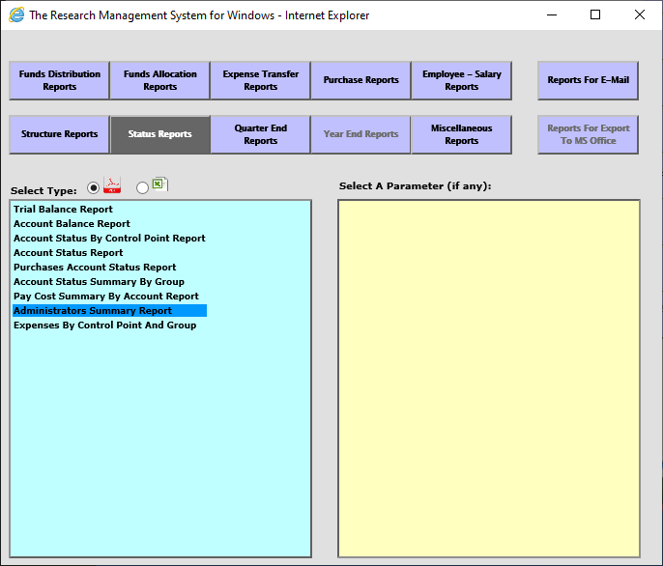
Administrators Summary Report

Slide 38
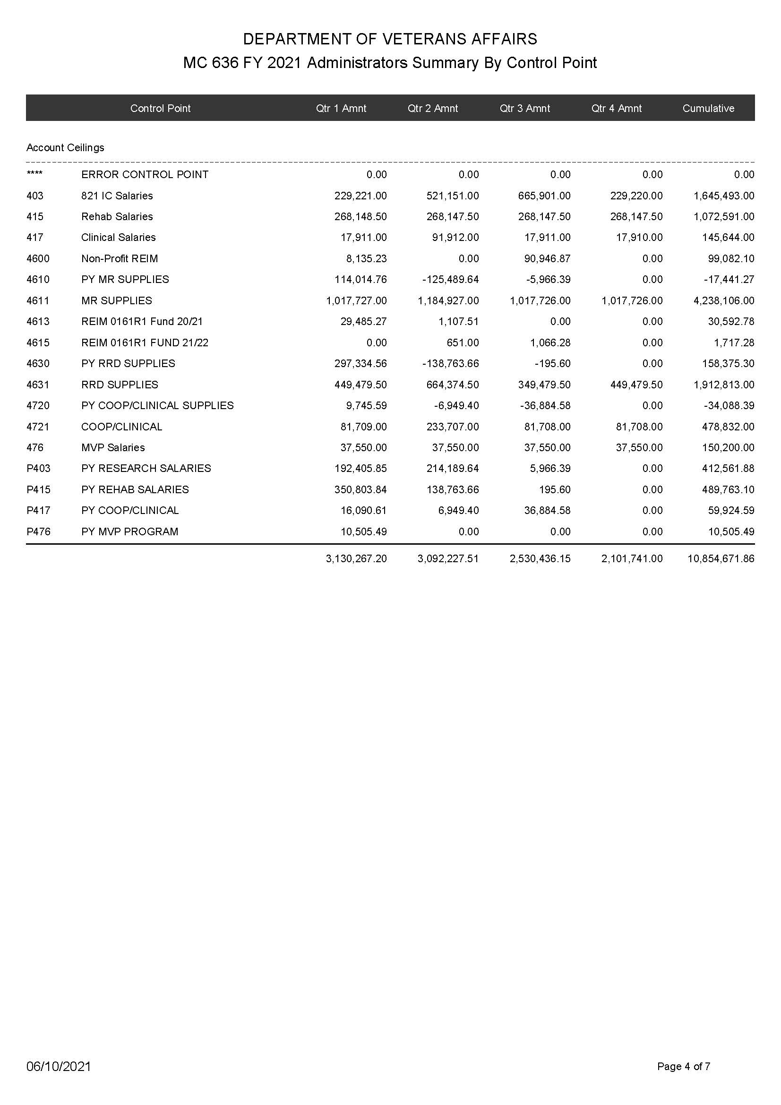
FCP 403 Administrators Summary Report

Slide 39
FCP 403 Status

Slide 40
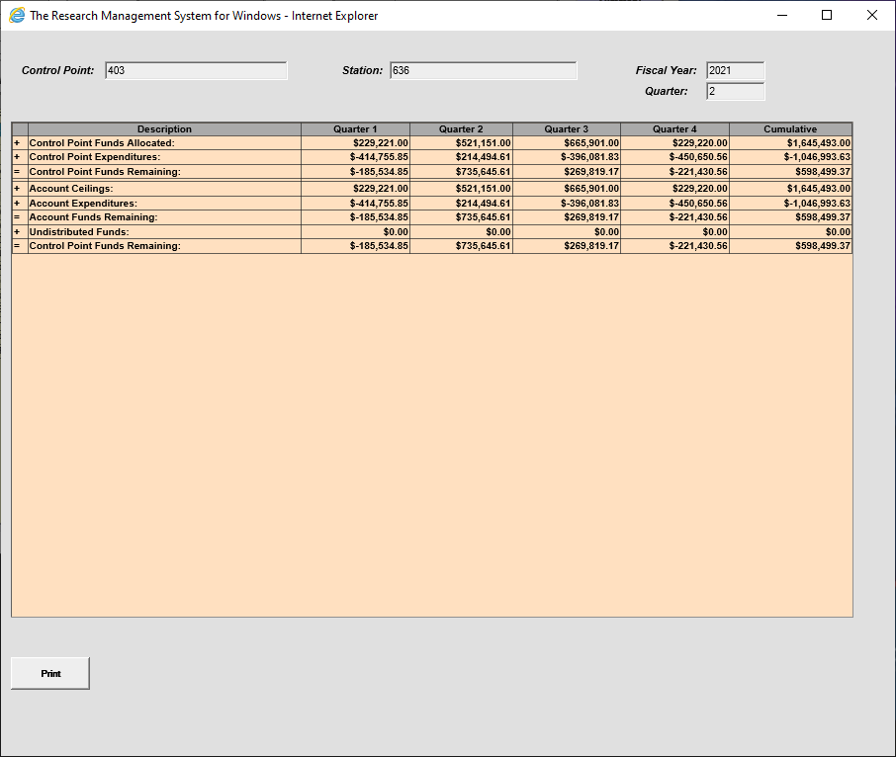
FCP 403 Summary Status

Slide 41
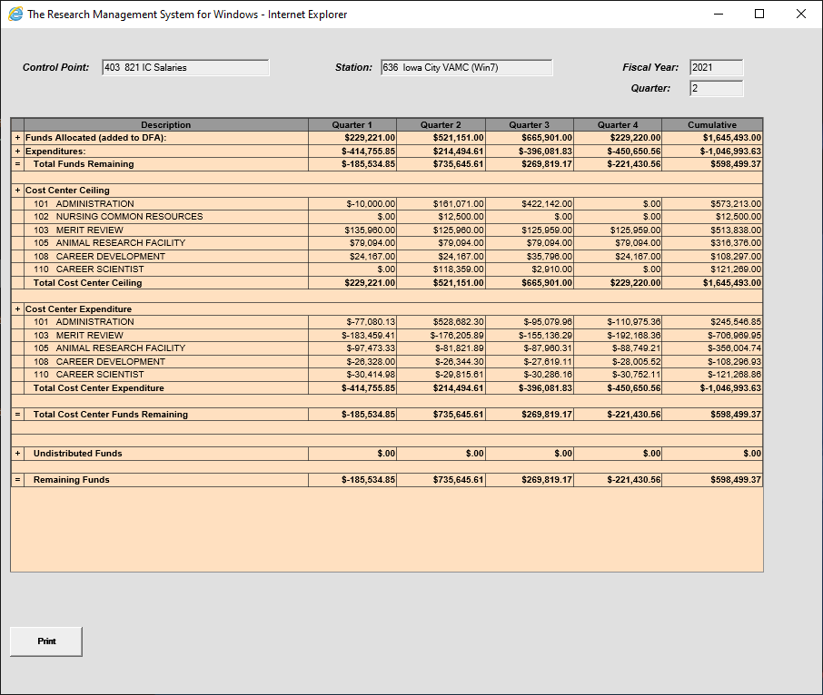
FCP 403 Detail Status

Slide 42
FCP 403 SOA
FCP | ACC | FCP Name | FMS Budget | FMS Oblig | FMS Unob | IFCAP Unob | IFCAP Pending | FMS Unob minus IFCAP Unob
 | 0161A1 FY 2122 Prog 81
403 | 810034401 | 821 IC SALARIES | 1,645,493.00 | 404,480.63 | 1,241,012.37 | 1,241,012.37 | 0.00 | 0.00

Slide 43
How to Balance Salary Expenses
Since WinRMS does salary projections, you will need to set-up an excel sheet to balance the salary expenses throughout the year in order to balance each pay period.
There are multiple ways the spreadsheet can be set-up. I have seen different ways of doing it. As long as you can track the expenses, your way works too! The next slide shows my simplified method.
To find the salary expenses that have downloaded into WinRMS each pay period, click on Reports ->Employee-Salary Reports ->Current Pay Period Report and then select the current pay period. This will show you the employees that have downloaded into each FCP and the amount for each FCP. That amount should then be entered into your spreadsheet.
You will want to ensure the FMS Obligated amount matches the spreadsheet amount for each FCP.
Let’s look at FCP 403 for Iowa City again.

Slide 44
Salary Spreadsheet
 | FCP 403 | FCP 415 | FCP 417 | FCP 476
PP1 | 66798.3 | 51696.64 | 2833.42 | 5888.35
PP2 | 67180.02 | 53949.72 | 5381.77 | 5888.34
PP3 | 67287.26 | 49335.6 | 5664.66 | 5888.35
TB1017 |  | 564.66
PP4 | 67358.1 | 49897.06 | 5666.82 | 5888.34
EW 636JI1320 | -18615.5
PP5 | 67420.84 | 49331.11 | 5671.16 | 5888.35
EW 636JI1362 | -480963.35
EW 636JI1364 | -134024.43
EW 636JI1368 |  | -288228.73
EW 636JI1369 |  |  | -23447.01
EW 636JI1370 |  |  |  | -10886.05
TB1017 |  | 400
PP6 | 67175.06 | 51412.74 | 5666.83 | 5888.34
PP7 | 68590.64 | 51556.71 | 5666.83 | 5888.34
PP8 | 68280.35 | 51556.7 | 5666.83 | 5888.35
EW 636JI1431 | -5966.39
EW 636JI1434 | -8833.34
EW 636JI1432 |  | -195.6
EW 636JI1433 |  |  | -28051.24
PP9 | 68590.4 | 51556.67 | 5666.83 | 5888.34
PP10 | 68280.39 | 51556.73 | 5666.83 | 5888.35
TB1017 |  | 200
TOTAL | 404480.63 | 563251.41 | 20828.81 | 89416.31
Transit Benefit
Cost Transfers

Slide 45
FCP 403 SOA Balance to Spreadsheet
FCP | ACC | FCP Name | FMS Budget | FMS Oblig | FMS Unob | IFCAP Unob | IFCAP Pending | FMS Unob minus IFCAP Unob
 | 0161A1 FY 2122 Prog 81
403 | 810034401 | 821 IC SALARIES | 1,645,493.00 | 404,480.63 | 1,241,012.37 | 1,241,012.37 | 0.00 | 0.00

Slide 46
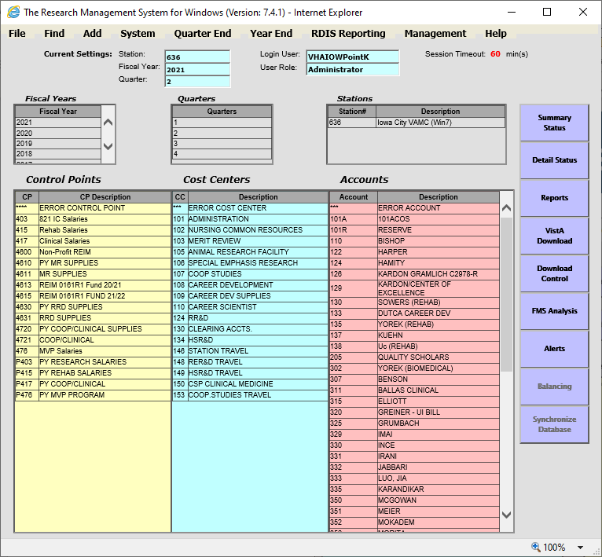
WinRMS Salary Report

Slide 47
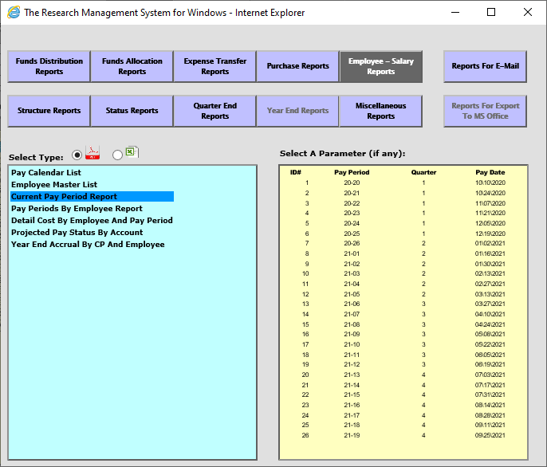
WinRMS Salary Report

Slide 48
TSP Transactions
You may see a TSP transaction hit the FCP and will look like the following on the F20 daily activity report:
To determine the individual that the charge is for so you can apply it to the correct account in WinRMS, you can do the following:
  Go to VSSC: VSSC - VHA Support Service Center (va.gov)
  Click on Journal Voucher Line Table (JVLT)
  Enter in your VISN, Facility, 0161A1 Fund, Select PR as Transaction Code and the accounting period you are looking in for the transaction. Then click on View Report.
  Once you locate the transaction, look at the description column and it will tell you the individual.
Transaction Date | ACC No | Document ID | BOC | Cost Ctr | Cost Ctr (6 digit) | Vendor Name | Obligations Beginning Balance | Obligation Adjustment Amount | Unobligated Ending Balance
20210114 | 810034401 | PR 999TSP2104N | 11 | 8101 | 810100 | CURRENT EMPLOYEE RECV ONLY | $410,605.29 | $3.99 | $282,197.72

Slide 49
Conclusions
Salary projections are a key component in WinRMS
Make sure you have the right access to the FCP
Setup your PY as salary transactions will hit throughout the year to both
Reconcile each PP
If you do not balance, you need to look for the anomalies
Use VSSC tools and the download CSV to help you

Slide 50
Availability of Recording
A recording of this session and the associated handouts will be available on ORPP&E’s Education and Training website approximately one-week post-webinar
An archive of this and other webinars can be found here: https://www.research.va.gov/programs/orppe/education/webinars/archives.cfm

Slide 51
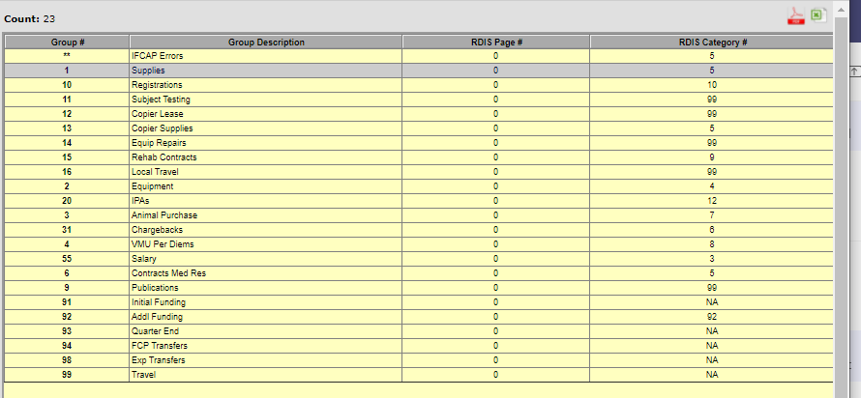

Slide 52
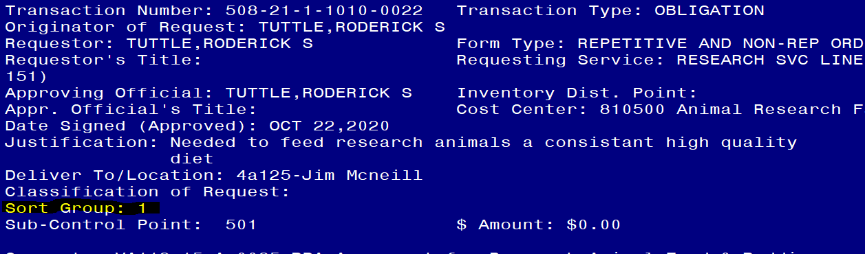

Slide 53
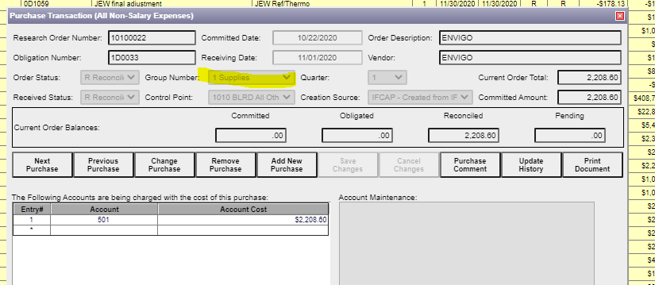

Slide 54
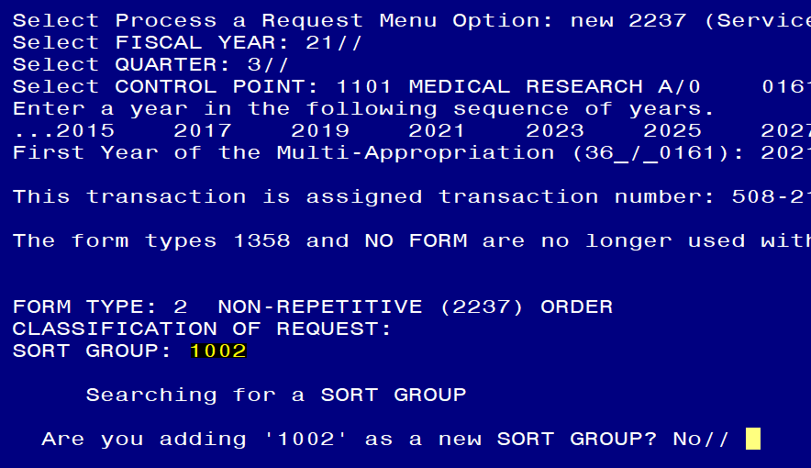

Slide 55
Questions??

